Slide 1
Web Security with Adversary Mindset
Dr. Soundararajan Ezekiel
Drew Rado
Vincent Emery

Slide 2
What is Web Security?
Range of security tactics for protecting activities and transactions conducted online over the internet
Various forms of communication, entertainment, financial, and work-related tasks are accomplished online
Tons of data and sensitive information
High risk of intrusion by hackers and other cybercriminals
Notes:
What Is Internet Security? | Trellix

Slide 3
Think like an adversary
The goal is to understand and attacker’s mindset to identify and anticipate attacks
It is a good idea to identify potential targets attackers may want to attack
Make sure you conduct penetration testing around these targets and keep them secure

Slide 4
Threat Modeling
Threat modeling is a process for identifying and prioritizing potential threats and vulnerabilities to a system or application.
The goal of threat modeling is to improve the security of a system by identifying potential attack vectors and implementing appropriate security controls.
There are five major threat modeling steps:
Defining security requirements.
Creating an application diagram.
Identifying threats.
Mitigating threats.
Validating that threats have been mitigated.
Notes:
Microsoft Security Development Lifecycle Threat Modelling

Slide 5
Tools for Threat Modeling
Notes:
Most Common web vulnerabilities. Web vulnerabilities are weak points or… | by Nader Medhat | Mar, 2023 | Towards Dev

Slide 6
Threat modeling manifesto
A community-driven effort to establish a set of principles and best practices for threat modeling.
It provides a framework for understanding the purpose and scope of threat modeling, and emphasizes the importance of collaboration, communication, and continuous improvement.

Slide 7
OWASP Threat Dragon
an open-source, web-based threat modeling tool that allows users to create, manage, and share threat models.
Threat Dragon supports various threat modeling methodologies, including STRIDE and DREAD, and integrates with other OWASP tools, such as the OWASP Top Ten and the OWASP Application Security Verification Standard.

Slide 8
Microsoft Threat Modeling Tool
a standalone tool for creating and analyzing threat models for software applications. It supports various threat modeling methodologies, including STRIDE and DREAD, and provides a customizable library of threats and mitigation strategies.
The tool allows users to visualize and analyze their threat models and provides guidance on how to address identified threats.

Slide 9
Common Web Vulnerabilities
Notes:
Most Common web vulnerabilities. Web vulnerabilities are weak points or… | by Nader Medhat | Mar, 2023 | Towards Dev

Slide 10
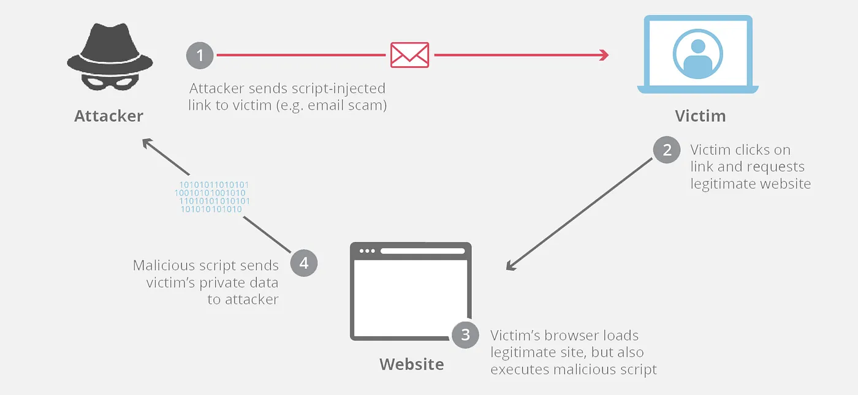
Cross Site Scripting
Allows attackers to inject malicious code into a webpage viewed by other users
Reflected XSS
Malicious script is included in the URL or other input field and is immediately reflected to the user
Stored XSS
Malicious code is stored on the server and executed every time the compromised web page is loaded

Slide 11
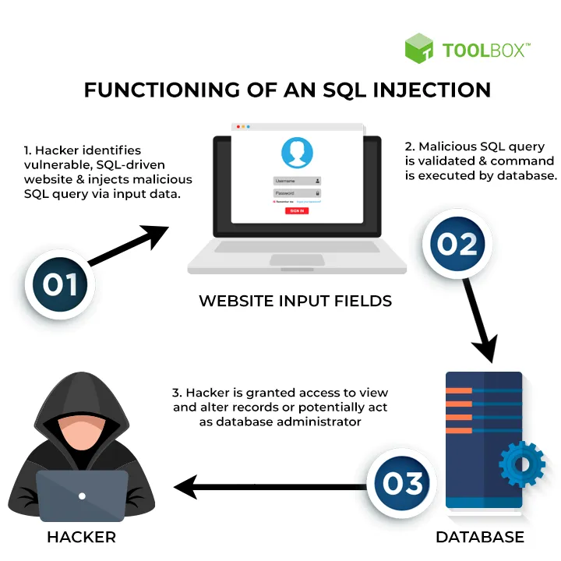
SQL Injections
When an attacker can run malicious SQL commands on the backend database of a web application
Example: " or ""="
Exploits UNION statements to retrieve data from two different tables
Error-based SQLi
Uses SQL error messages to retrieve information about the database's structure or contents
Blind SQLi
When application does not provide any feedback to the attacker, but they can use timing/Boolean based techniques to infer information about the database or modify contents

Slide 12
denial-of-service attack
When an attacker overwhelms a website or application with fake requests causing it to become unusable to actual authorized users
Network Flooding
Attacker floods network with large number of requests, overwhelming the bandwidth and resources of the server
Distributed Denial of Service (DDoS)
Attacker uses a bot net to launch coordinated attacks from multiple sources. It is harder to block multiple sources quickly to mitigate the attack

Slide 13
Social Engineering
The use of deception to manipulate individuals into divulging confidential/personal that can be used to
Attackers act like they are from a trusted organization, or try to impersonate a person the victim knows
Usually try to gain passwords, DOB, or bank details
All it takes is one fooled victim to trigger an attack that can affect an entire system
Notes:
What Is Social Engineering in Cyber Security? - Cisco

Slide 14
GhostShell SQL Attack - 2012
Attacker group called GhostShell targeted 53 universities using SQL injection
Including Harvard, Stanford, Cornell, and Princeton
Stole and published 36,000 personal records of staff, faculty, and students
GhostShell said their goal was to bring public attention on the state of higher education
Part of larger attack project named white fox
Notes:
Hackers post data from dozens of breached college servers (cnet.com)

Slide 15
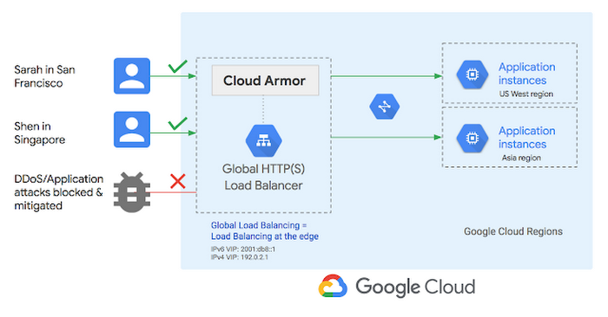
Google Cloud DDOS Attack - 2022
On June 1st, 2022, hackers targeted a Google Cloud customer's storage system
Through several Chinese IPs, hackers sent 46 Million requests per second
76% larger than the previous record holder

Slide 16
Tools for Threat Hunting
Burp Suit
A popular web application testing tool that allows users to intercept, analyze, and modify HTTP requests and responses.
Burp Suite is often used for manual web application testing and can help identify vulnerabilities such as SQL injection and cross-site scripting (XSS).
Metasploit
A powerful framework for developing and executing exploit code against target systems.
Metasploit can be used for both offensive and defensive purposes and can help identify vulnerabilities and test the effectiveness of security controls.
Nmap
A network exploration and security auditing tool that allows users to scan and map network hosts and services.
Nmap can help identify open ports, operating systems, and potential vulnerabilities in target systems.

Slide 17
Tools for Threat Hunting
Cobalt Strike
A commercial penetration testing tool that provides a suite of advanced features for conducting targeted attacks against specific organizations or systems.
PowerShell Empire
A post-exploitation framework for Windows environments that allows users to conduct various operations such as lateral movement, data exfiltration, and privilege escalation.
PowerShell Empire uses PowerShell, a built-in Windows tool, to execute commands and bypass traditional security controls.
Cobalt Strike includes features such as Beacon, a powerful payload for establishing a foothold on target systems, and Malleable C2, a tool for customizing the behavior of command-and-control traffic.

Slide 18
Report and patch found vulnerabilities
Once vulnerabilities have been identified, they should be reported to the appropriate parties in a timely and responsible manner.
Vulnerability reports should include a detailed description of the vulnerability, including its potential impact and severity.
The report should also include steps to reproduce the vulnerability and any recommended mitigation strategies.
Users and organizations should apply patches and updates as soon as they are available to reduce the risk of exploitation.

Slide 19
Conclusion
Web security is a critical aspect of any web application or website and requires a proactive and continuous approach to identify and address potential threats and vulnerabilities.
By understanding and adopting the mindset of an adversary, implementing threat modeling methodologies, and promptly reporting and patching vulnerabilities, organizations can improve the security of their web applications and protect their users' data and privacy.

Slide 20
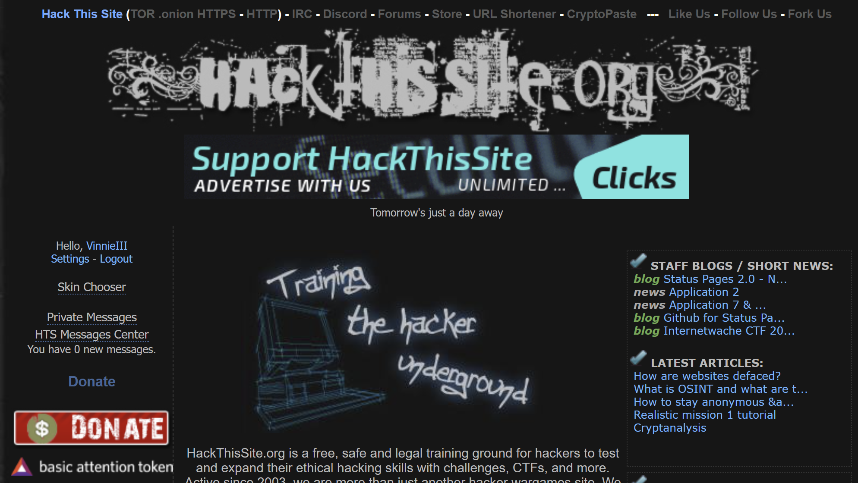
Hack the site
www.hackthissite.org

Slide 21
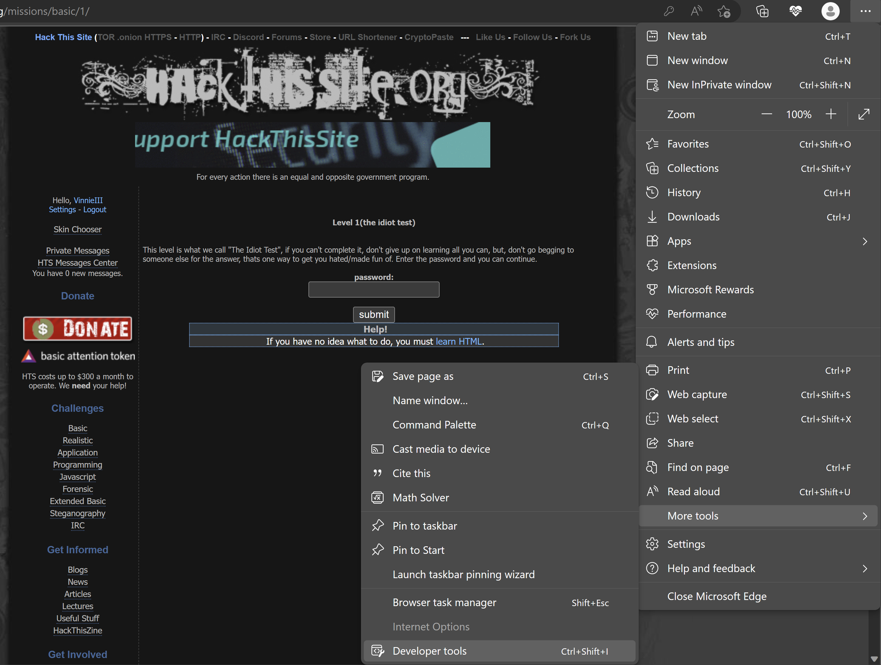
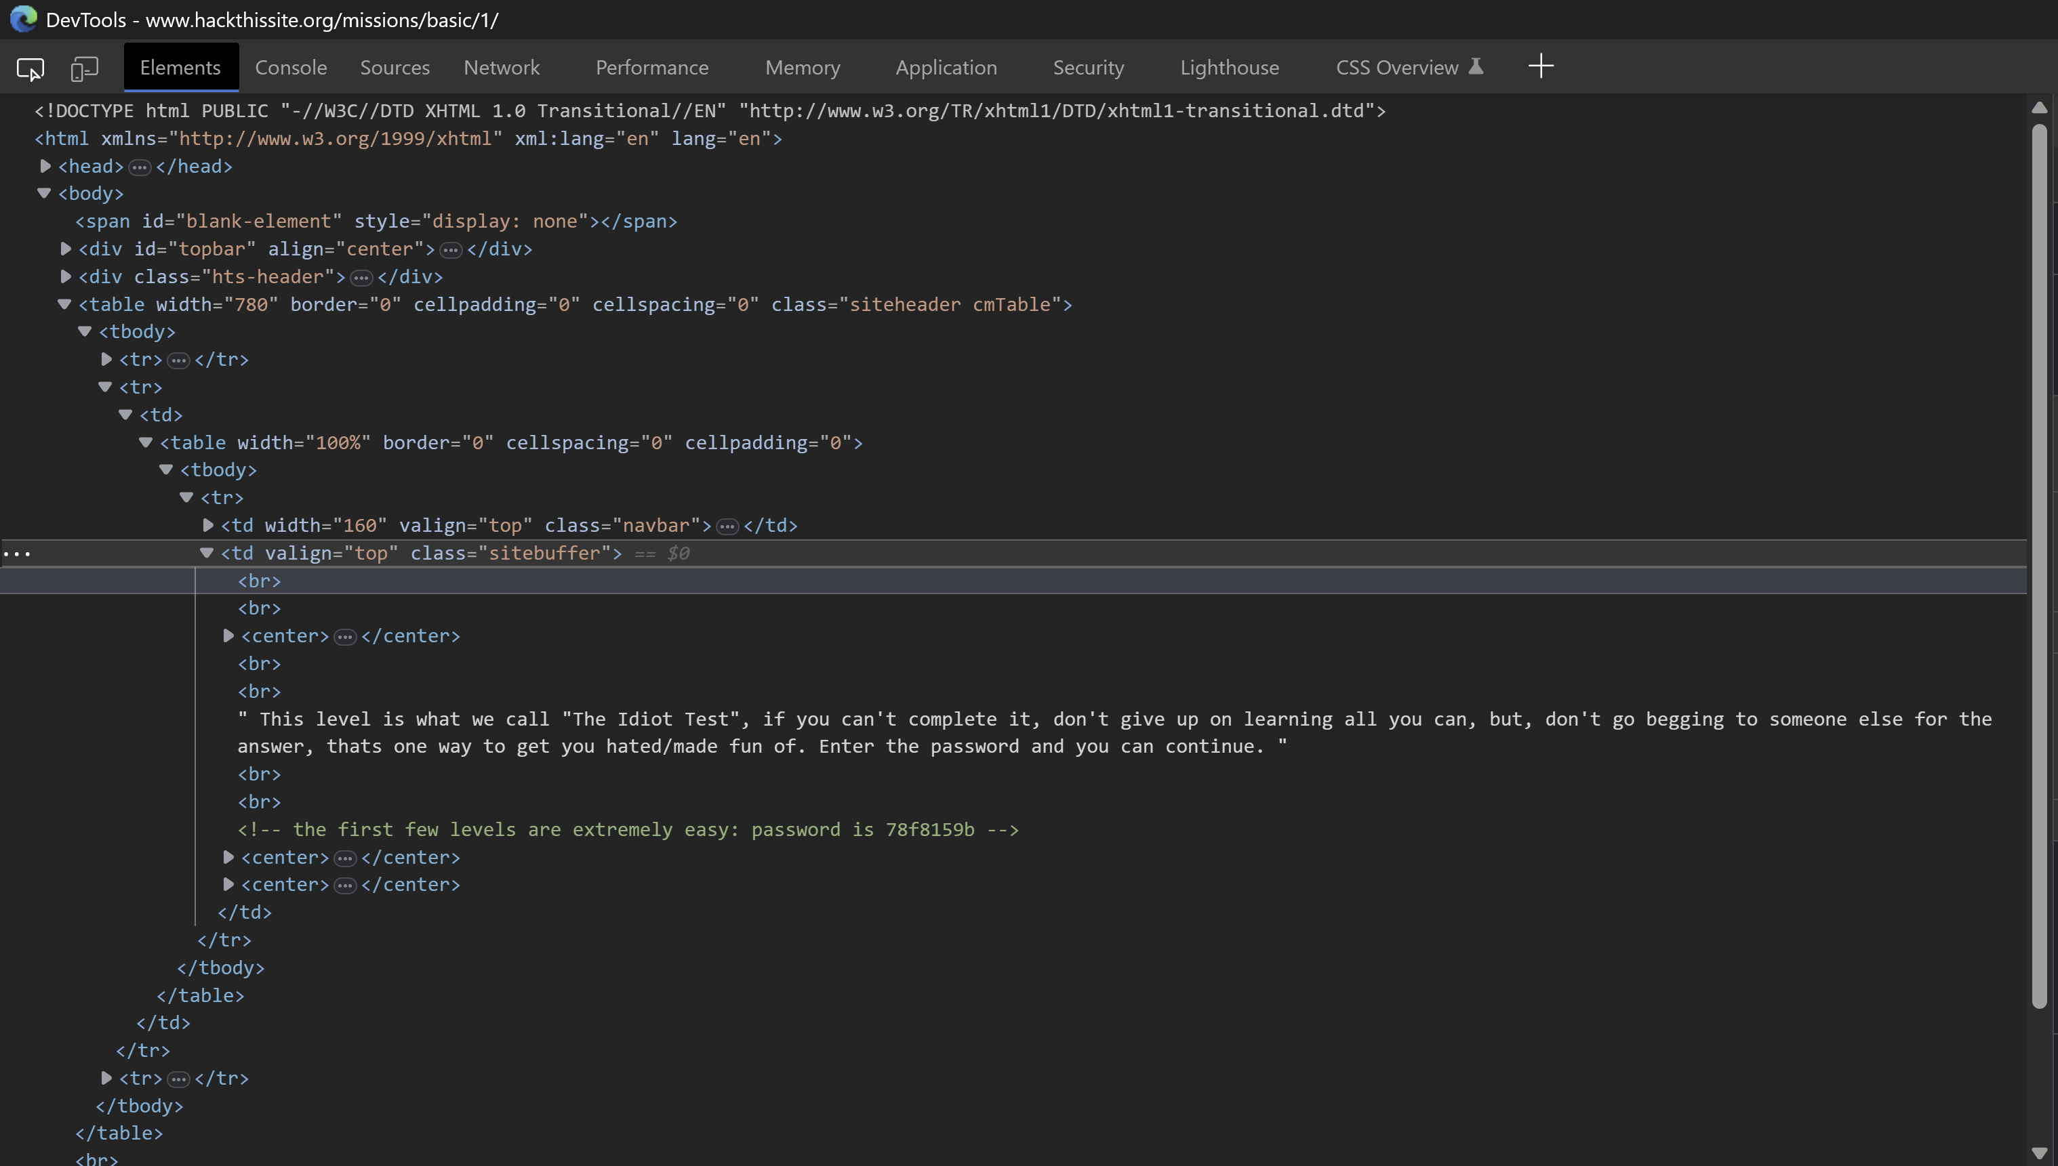
Basic HTML
You can view/edit the layout of a page using developer tools on any website
Get to this through pressing fn + F12 or through settings
To edit the page, go to the elements tab at the top right where you can see the code for the page

Slide 22
Some Linux Commands
Ls – list all files and directories in the directory you are in
.. - represent the parent directory
. - represents current directory
; - command separator allowing you to have multiple commands on the same line
Dotfiles – hidden files in file system that are not displayed using ls

Slide 23
Activity
Complete first 11 Basic exercises
Each level will give you hints on how to get the password
Lab sheet with instructions on D2L

